Slide 2
Future-Proofing Your On-Premises SharePoint Development
BRK4111
Vesa Juvonen
Senior Program Manager
Microsoft

Slide 3
Agenda
Transformation approaches
Farm solution considerations
Development models for on-premises

Slide 4
Recommendations
Understand impact of farm solution
Transform end user experience, not code
Move gradually to app model
Avoid Sandbox solutions
Notes:
Vesa

Slide 5
Development model
What are the recommendations for the development model?

Slide 6
App model with add-ins is the future also for on-premises

Slide 7
“Will Farm Solutions be supported with SharePoint Server 2016?”
Yes.
We will make investments primarily on the app model side also for on-premises to better align the development story: Write once and use it across cloud and on-premises
Notes:
Vesa

Slide 8
“Will you ever support farm solutions in Office 365?”
No.
Farm solutions are deployed cross SharePoint farm and they’d impact multiple customers…
Notes:
Vesa:
Time: 42:00

Slide 9
“I saw a blog post on the Internet saying that the app model is dead”
No it’s not
It’s more alive than ever. We are committed to this model and the majority of our development investments are made on the app model for cloud AND on-premises
Notes:
Vesa

Slide 10
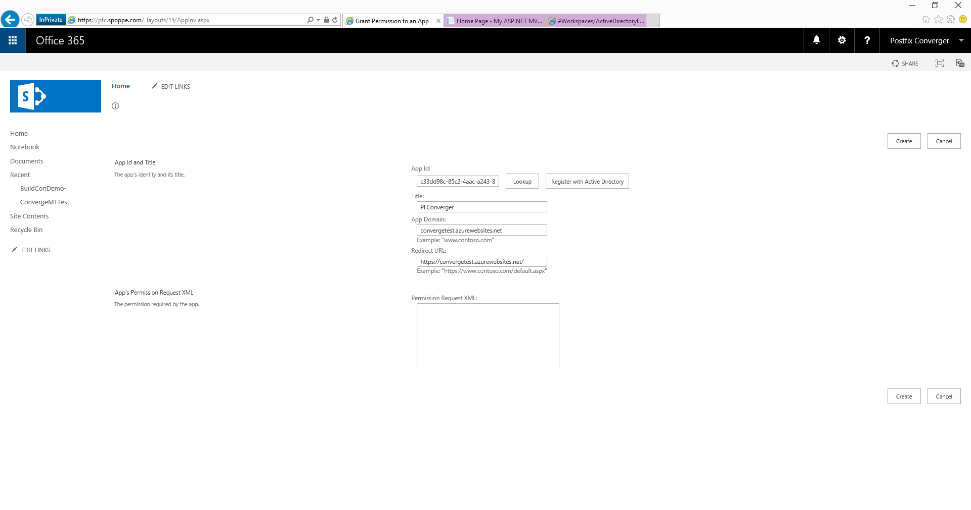
//…/layouts/15/appinv.aspx
Coming soon: “Register with Active Directory”
SP Add-In registered also to Azure AD
Get Access to cross Office 365 services for your SP add-ins
Office 365 and on-premises with SharePoint 2016

Slide 11
What if…
We would use same development model in cloud and in on-premises?
Notes:
Is that Tobias?

Slide 12

What does “app model” or “add-ins” mean in our terminology
SharePoint Add-Ins means all operations which are executed outside of the server
Classic - Full trust solutions
ISV solutions
Client Side Solutions
Remote provisioning for elements
Store apps
App catalog based solution
Custom service applications
Custom WCF services
Platform level customizations to on-premises
Server side controls as JavaScript on page layouts and master pages
Embracing un-ghosted model
SP App dimension with provider hosted apps to provide new capabilities
Packaged reusable solutions built for specific functionality
SharePoint customizations, not customer specific customizations
Customer specific customizations
Not only for market place or store, but also as platform for customer specific customizations

Slide 13
Transformation process
How to perform the transformation to app model gradually?

Slide 14
“What does app model transformation mean?”
Rewrite
Rewrite your code to app model. There’s actually no migration or transformation, but you can reuse concepts and patterns…
Notes:
Vesa

Slide 15
“What does this mean in practice?”
Implement similar functional capabilities as with farm solutions, using alternative technical solutions
Notes:
Vesa

Slide 16





Transformation process
Readiness
Assessment
Planning
Implementation
Deployment
Readiness with app model topics
Hosting decisions
Network impact analysis
Development model readiness
Analyze existing solution usage
Analyze existing code and functionality
Concentrate on business and functional requirements, not on technology
App model solution planning and design
What patterns and models are used for different solutions
What solutions can be converted to out of the box capabilities
Detailed technical planning
Actual app model solution implementation
Typical development process, including testing
App solution deployment
Existing content retrofitting
Farm solution retraction

Slide 17
DEMO
Transformation project templates and tooling
Notes:
Provision site columns and content types using feature receiver

Slide 18

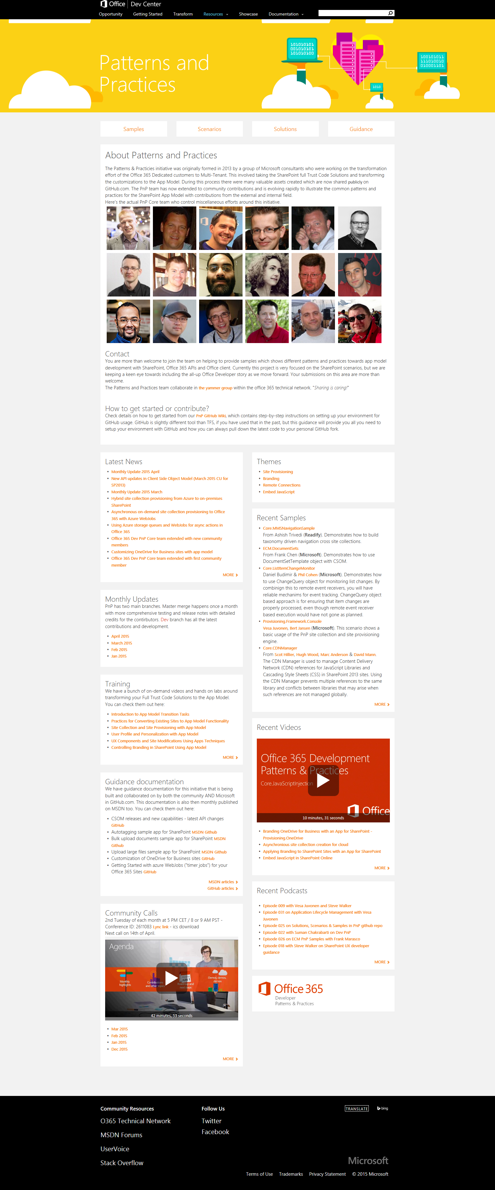
“Sharing is caring”
aka.ms/OfficeDevPnP
aka.ms/OfficeDevPnPYammer
aka.ms/OfficeDevPnPMSDN
aka.ms/OfficeDevPnPVideos
aka.ms/OfficeDevPnPTraining

Slide 19
Farm solution considerations
If you are still doing farm solutions, what are the recommendations to follow for making future transition easier?

Slide 20

Recommendations for farm solutions
Recommendations for following components
Content types and site columns
List Definitions
Field types
Site provisioning
Timer jobs
Recommendations to avoid future maintenance and rework of your deployment

Slide 21
”I want to minimize challenges in future updates with farm solutions”

Slide 22
Any element which creates dependency in content for farm solution is a challenge…

Slide 23

Content Type and site columns challenge
What
Rather than using feature framework elements in farm solution, it is recommended to provision site columns and content types using code
Why
Objects are created directly to the database (unghosted) without any dependencies on files in file system
How
Use code called from feature receiver to create needed elements
Notes:
Title: Extending oob web parts
Time: 1 minute
You have to end up writing code nayways when you want to upgrade from V1 to V2 of your solution. Why not just write the code.

Slide 24
Content type and site columns with dependency Not recommended approach
Configuration database
Manifest xml in the solution package introduces the feature framework elements.
Content database
WSP package
1
\\15\templates\features\FeatureA
Feature framework feature with element xml files for content type and site columns.
2
xml
Provisioned content types And site columns have dependency on element xml files
3
Content Type A
Content Type B
Content Type C

Slide 25
Content type and site columns without dependency Recommended approach
Configuration database
Manifest xml in the solution package introduces the feature framework elements.
Content database
WSP package
1
\\15\templates\features\FeatureA
2
Feature with feature receiver creating content types and site columns directly to content database using code
xml
Content Type A
Content Type B
3
Content types do not have any dependency and farm solution can be retracted without any impact to them
Content Type C
Notes:
2

Slide 26
List definition challenge
What
You should avoid custom list templates for your list instances
Why
Custom list template has unique identifier and it creates dependency on the list instances to the schema.xml file of the list template
How
Consider using code to provisioning specific instances or use custom schema option with instances
List events for newly created lists in sites
Notes:
2

Slide 27
Challenge with the list definitions
Configuration database
Manifest xml in the solution package introduces the feature framework elements.
Content database
WSP package
1
\\15\templates\features\FeatureD
2
Feature framework feature with element xml files for list templates/list definitions.
xml
Provisioned list instances have dependency on the schema file deployed using feature framework
3
List definition A
List definition B

Slide 28
How to fix existing deployments?
There’s unfortunately no easy ways to fix existing deployments which are using custom list definitions
We are working on more guidance on this side with details on how to fix the existing sites
Possible solutions
Change to use Sandbox solution list definition
Perform content migration to oob list

Slide 29
DEMO
Custom list definition challenge with farm solutions
- How and how to fix?

Slide 30
Custom field type challenge
What
Do not use custom field types with you farm solutions
Why
Data stored in the database will have dependency on the custom field type, which will cause challenges in migration scenarios
How
Consider using only field controls for presentation or use client side rendering for list editor overrides
Notes:
2

Slide 31
DEMO
Custom field type – What is the alternative?

Slide 32
Site definition / web template challenge
What
You create sites using site definitions in on-premises can be challenging
Why
Site upgrades cross versions is natively upgraded and you will need to own the template model by yourself
How
Consider models where we start with out of the box site provisioning, which is configured with business requirements
Notes:
2

Slide 33

Site Provisioning Options/Comparison
Site Definition
Site Templates
Web Templates
SP Server side provisioning
Remote provisioning
No Office365
Long term impact on costs
Blocks transition to cloud
Causes significant issues with future migration and upgrade
Poor site collection creation story
Negative impact on upgrades
Causes additional maintenance costs with service updates
Not with publishing features
Poor site collection creation story
Causes maintenance costs with service updates and possibly with CUs
Provision oob sites, but modify them based on user selection and requirements
Standardization of site creation in code
No Office365
CSOM supports creation of site collections for on-premises and cloud
Standardization of site creation in code
Can be done from any external system
Options
Support in cloud
Options available
Good
Fair
Average
Good
Excellent
Cost impact (short and long term)
Notes:
Vesa
For more information on provisioning sites and associated terminology see:
SharePoint 2010 and web templates, http://blogs.msdn.com/b/vesku/archive/2010/10/14/sharepoint-2010-and-web-templates.aspx
Site provisioning techniques and remote provisioning in SharePoint 2013, http://blogs.msdn.com/b/vesku/archive/2013/08/23/site-provisioning-techniques-and-remote-provisioning-in-sharepoint-2013.aspx

Slide 34
DEMO
Remote provisioning with SharePoint
Sub sites and hybrid twist…

Slide 35
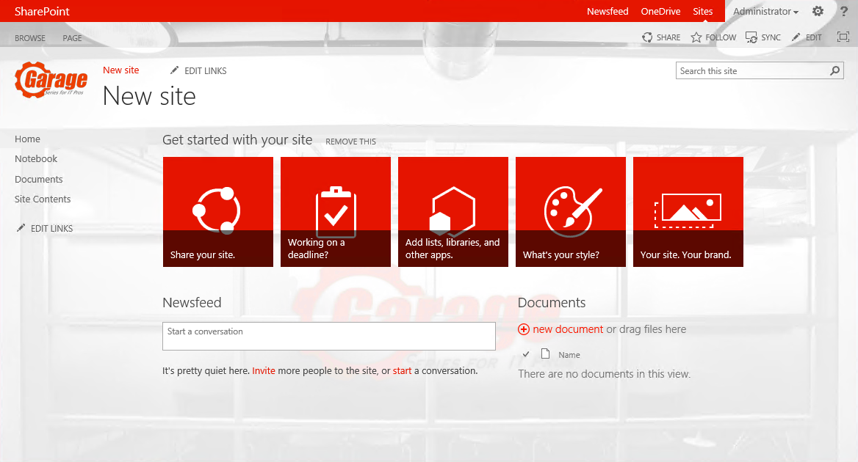
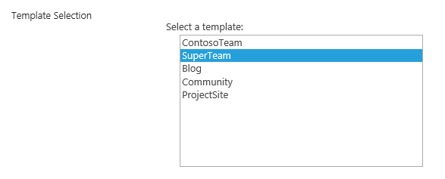
Hybrid provisioning from Azure
Company
SharePoint Farm
2
5
Storage Queue
6
1
Service Bus Relay
https://teams.contoso.com /sites/site
Provider Hosted Apps
WebJob
SharePoint Service
Based on the end user selection, actual creation of the site collection will be done either to on-premises or to the cloud.
3
4
https://contoso.sharepoint.com /sites/site
http://aka.ms/OfficeDevPnPVideos - Hybrid site collection provisioning from Azure to on-premises

Slide 36
Recommendations
Understand impact of farm solution
Transform end user experience, not code
Move gradually to app model
Avoid Sandbox solutions
Notes:
Vesa

Slide 37
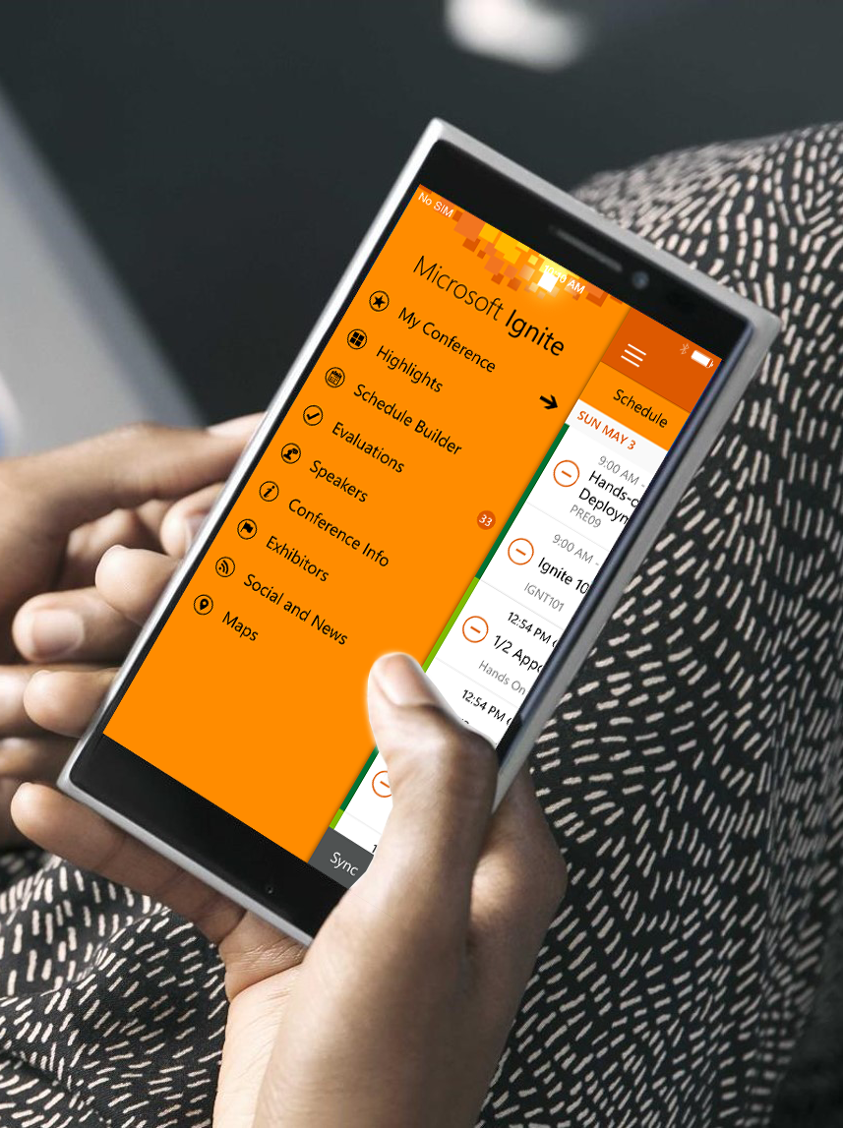

Please evaluate this session
Your feedback is important to us!
Visit Myignite at http://myignite.microsoft.com or download and use the Ignite Mobile App with the QR code above.

